Slide 1




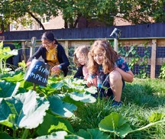

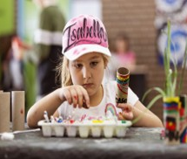

Vacation Care bookings are now online.
Uniting OSHC MLC Burwood
For existing families using the same OSHC service – book in using your Kidsoft Parent Portal account.
Scan the QR code to book or reset your password, or contact elsupport@uniting.org for support.
Spring into fun
Explore • Create • Connect
Spring 2026
Holiday Program
For families not currently enrolled at OSHC, or who have not attended
for 12 months – visit uniting.org/contact-us/enquiry-form
Hours | 8am – 6pm
Cost | Centre Fun Day: $83.70 Casual Vacation Care Fee: $89.10 Incursion and excursions costs are additional and will be added to the daily fee for the days these activities are scheduled.
Meals | Afternoon tea is provided.
Allergy awareness | Please note that we are a “nut and egg free” and allergy aware service. We ask that you do not pack any food which contains nuts. These may include, but are not limited to, Nutella, peanut butter and nut bars. Children with anaphylaxis are enrolled at the service.
What to bring | Please remember to pack a full brimmed hat, water bottle, sunscreen, lunch box and spare clothes. Please remember to leave all electronic devices at home, this includes iPad/tablets and gaming consoles.
What to wear | Children attending care must wear enclosed shoes and a shirt that covers their shoulders.
Service contact details | Bookings and enrolment support: elsupport@uniting.org or 02 7203 8900 Service email: mlcoshc@uniting.org Service coordinator: Sabreen Banu, 0409 301 665
Bookings closing date | 18/09/2026 For late bookings please contact elsupport@uniting.org or call 02 7203 8900 Bookings made after the Vacation Care program has commenced will be charged the Casual Vacation Care fee.
Terms and conditions | All children must be enrolled with the service prior to booking in vacation care sessions. Childcare Subsidy is only applied to the regular daily fee and does not cover community partnership/excursion costs. Payments will be taken weekly on each Thursday of the vacation period. Cancellation of any vacation care sessions requires 5 days written notice. In the absence of required notice, regular session fees will be charged. Children must arrive at the service before any scheduled departure on excursion days. Programs, Community Partnership activities and excursions may change to accommodate adverse weather conditions or due to unforeseen circumstances. Parents will be informed of any changes. We support all children including children with additional needs; please feel free to provide any information about your child’s needs at the time of enrolment.
Teddy Bear Picnic
Blooming Garden Adventure
Giant Games
Arts and Science Quest
We’re open to children from any primary school – your family and friends are welcome.
Places are limited, book today.
CCS approved
Eligible families may receive up to 90% of their childcare costs subsidised through the Australian Government Child Care Subsidy (CCS). Terms and eligibility criteria apply.
Scan the QR code to visit our website, view the full program and book.

Slide 2



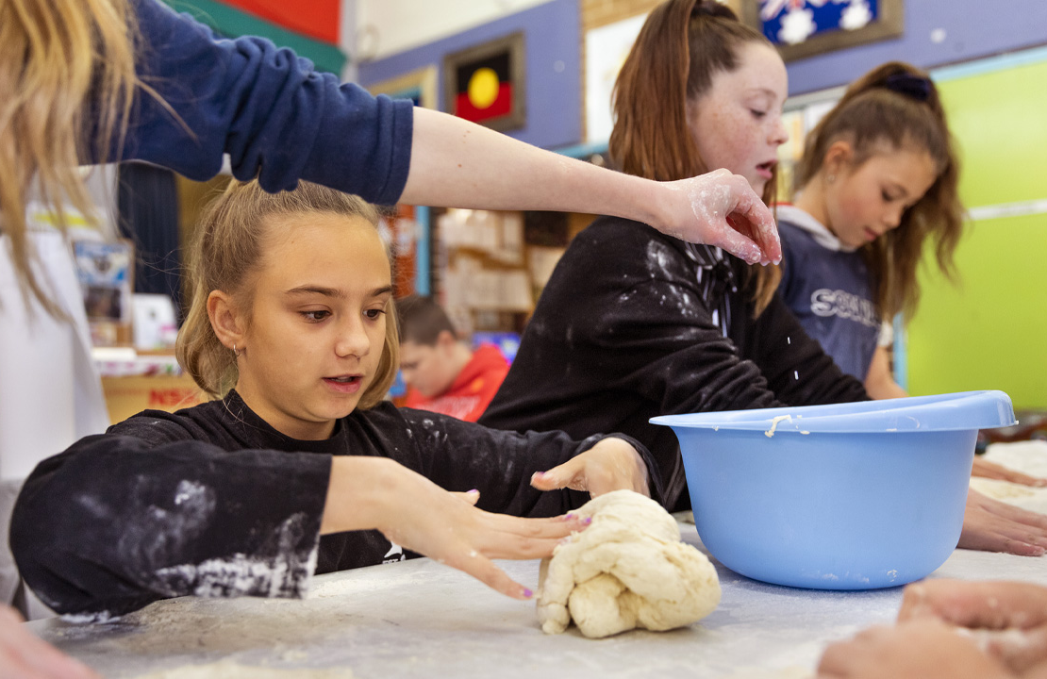



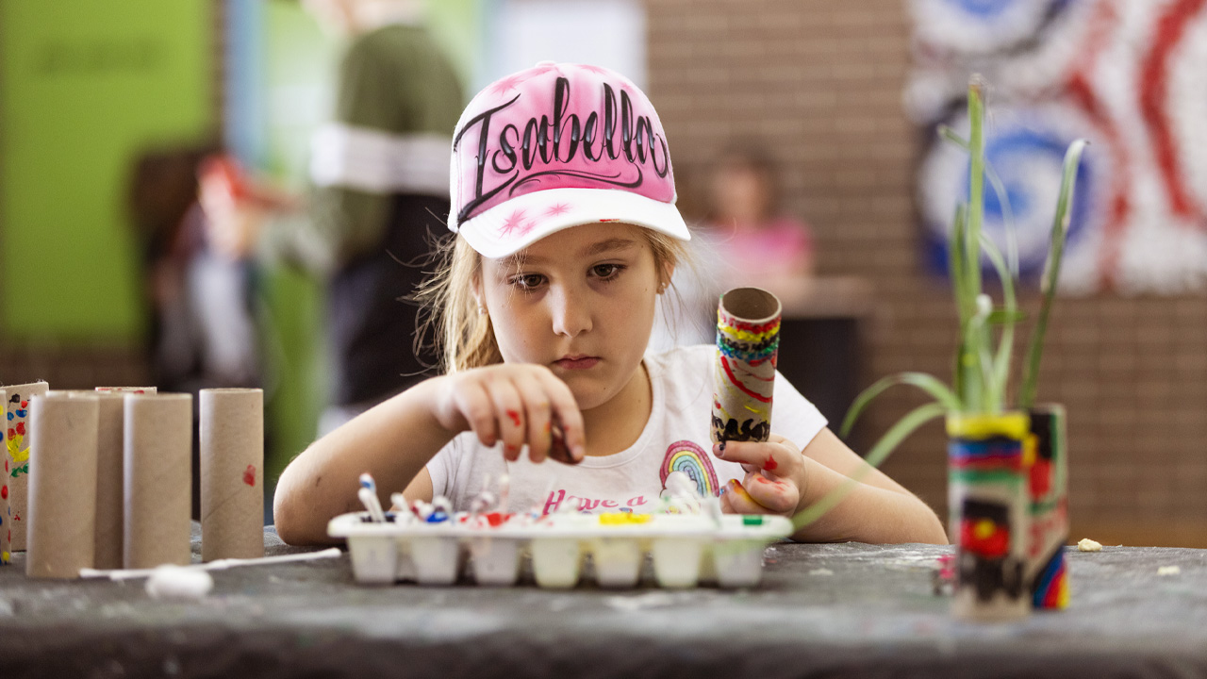

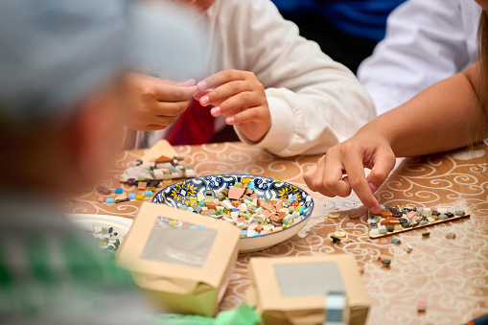


Week 1 holiday program
Monday 21 September | Tuesday 22 September | Wednesday 23 September | Thursday 24 September | Friday 25 September
Unleash your creativity as you design a colourful mandala masterpiece using variety of art materials and patterns! Children will explore symmetry and artistic design while creating a unique keepsake to take home. Children’s choice | Get ready for an action-packed martial arts! Children will learn basic martial arts skills through exciting games and challenges while building confidence, coordination, discipline and teamwork in a safe and respectful environment. Children’s choice | Step into a magical spring wonderland of creativity as children create fairy gardens, mushroom houses, butterflies, flowers and more! A fun day of exploring creativity, imagination and nature through art. | Travel the world through food! Children will create recipes inspired by diverse cultures, including Aboriginal and Torres Strait Islander traditions, while developing cooking skills and learning about culture and connection through food! Children’s choice | Bring along your favourite teddy for a fun-filled picnic on the MLC School grounds! Enjoy outdoor games, stories, music and a picnic while spending time with friends and furry companions. Children’s choice
$ 83.70 Centre Fun Day | $ 100.70 Community Partnership Visit | $ 100.70 Community Partnership Visit | $ 83.70 Centre Fun Day | $ 83.70 Centre Fun Day
Uniting OSHC
MLC School Burwood
  12-16 Park Rd,
  Burwood
  NSW 2134
Adventure, creativity and friendship await!
Our Vacation Care program is packed with exciting activities, themed days, incursions and excursions designed to keep children engaged, active and inspired.
Every day brings new opportunities to explore, create, learn and make unforgettable holiday memories with friends.
Magical Mandela Creations
Black Belt Warrior Martial Arts
Art on Canvas
Multicultural Cooking Experience
Teddy Bear Picnic
Week 2 holiday program
Monday 28 September | Tuesday 29 September | Wednesday 30 September | Thursday 1 October | Friday 2 October
Get ready for some outdoor fun! Children will enjoy a variety of giant games, including Jenga, Connect Four, Twister, Snakes & Ladders, Checkers and more. The activities encourage teamwork, friendly competition and active play. Children’s choice | Step into a world where creativity meets curiosity! Children will explore hands-on art and science activities, experiment with colours and materials, and discover creative ways to explore the wonders of science. | Discover the wonders of gardening this spring! Children will dig, plant and grow flowers, herbs and vegetables while exploring how plants grow. It’s a fun-filled day of hands-on of outdoor learning, discovery and fun. | Discover the art of mosaics as children design colourful creations using different shapes, patterns and materials. This hands-on activity encourages creativity, patience and imagination, with each child creating a unique masterpiece to take home. Children’s choice | Lights, camera, action! Join us at MLC OSHC for a movie day complete with a family-friendly film, popcorn and tasty treats. Sit back, relax and enjoy a fun day with friends. Children’s choice
$ 100.70 Community Partnership Day | $ 100.70 Community Partnership Day | $ 83.70 Centre Fun Day | $ 83.70 Centre Fun Day | $ 83.70 Centre Fun Day
Giant Games
Arts and Science Quest
Blooming Garden Adventure
Mosaic Masterpieces
Movie Mania at MLC OSHC

Slide 3





Week 3 holiday program
Monday 5 October | Tuesday 6 October | Wednesday 7 October | Thursday 8 October | Friday 9 October
Service Closed | Get ready to move, groove and have fun! Children will learn exciting dance routines inspired by the latest trends while building confidence, coordination and rhythm in a fun and inclusive environment. Children’s choice | Unleash your inner designer and create your own sparkling treasures! Children will explore their creativity by designing and making unique jewellery pieces using colourful beads, charms and creative materials. | Let your imagination flow in a colourful painting adventure! Children will explore their creativity through a guided art activity, creating their own unique masterpieces. A relaxing and inspiring day of creativity and artistic expression. | Celebrate the final day of Vacation Care in your favourite pyjamas! Enjoy a fun-filled day of movies, games, crafts, music and tasty treats as we wrap up the holidays with friends. Children’s choice
 | $ 100.70 Community Partnership Visit | $ 80.70 Centre Fun Day | $ 83.70 Centre Fun Day | $ 83.70 Centre Fun Day
Labour Day
Viral Dance Trend
Enchanted Jewellery Workshop
Sip, Splash & Create Studio
The Grand Pyjama Finale
Adventure, creativity and friendship await!
Our Vacation Care program is packed with exciting activities, themed days, incursions and excursions designed to keep children engaged, active and inspired.
Every day brings new opportunities to explore, create, learn and make unforgettable holiday memories with friends.

