Slide 1
Junior School Sport Strategy
Fostering Excellence in Sports and Academics
Matt Tyson
Head of Sport (K-6)

Slide 2
Aim
To create a vibrant sports culture within the Junior School at Pymble Ladies’ College.
By increasing students' sports participation and performance, we aim to enhance student’s physical wellbeing and nurture a holistic development that enhances academic learning.

Slide 3
Evidence based benefits
Physical Health: Engaging in sports promotes physical fitness, strengthens muscles, improves cardiovascular health, and enhances coordination and balance.
Mental Health: Regular physical activity can reduce stress, anxiety, and depression and boost overall mood and self-esteem.
Academic Performance: Participation in sports has a positive correlation with cognitive development. It helps in improving concentration, memory retention, and classroom behaviour, which collectively improves academic learning.
Teamwork and Leadership Skills: Sports encourage team dynamics, leadership, and communication skills that are crucial in all areas of life.
Discipline and Time Management: Balancing sports and academics teaches students effective time management and discipline.

Slide 4
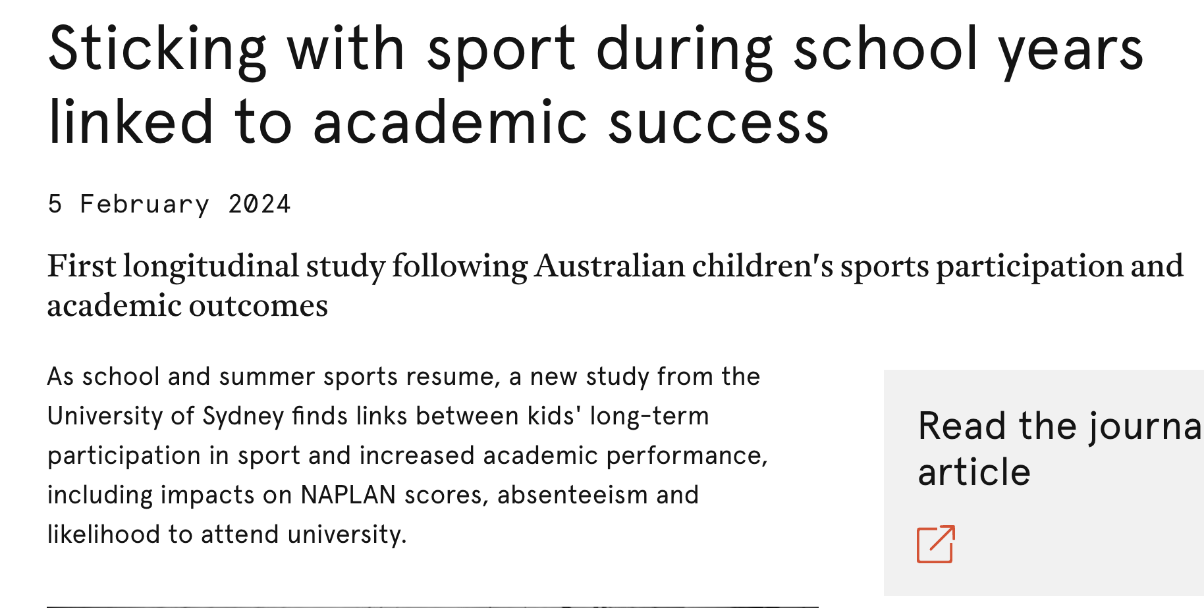
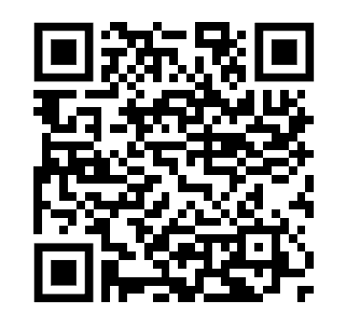
Academic Performance
Children who continued sport participation had higher academic performance across all academic outcomes of the study.
Children who participated in team sport had better performance on attention and working memory and were more likely to be awarded the HSC/equivalent.
Children involved in individual sport reported higher NAPLAN literacy results and had a higher academic performance at the end of school (ATAR).
Notes:
In the first long-term study of its kind, published in the Journal of Physical Activity and Health, the researchers followed the sports participation of over 4000 Australian children from age 4 to 13. They then matched this with academic trajectory up to 21 years-of-age.

Slide 5
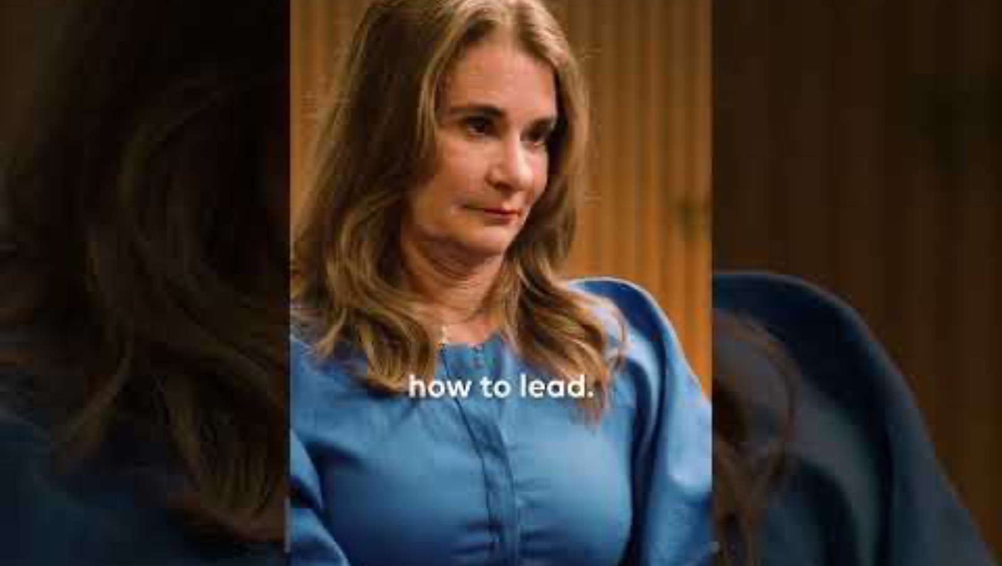
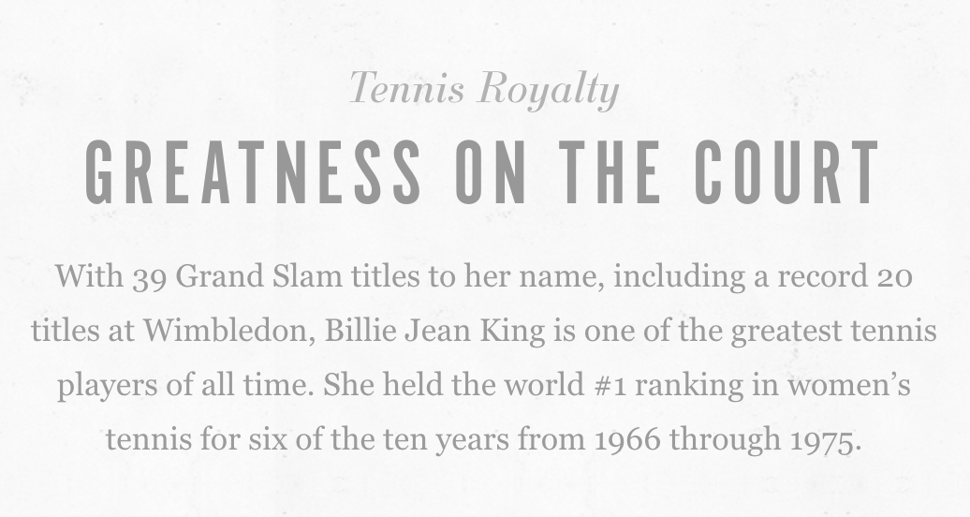
Teamwork and Leadership Skills
According to a report by Ernst & Young polling 821 high-level executives, 90% of female executives played sports when they were younger, rising to a staggering 96% of those employed in Senior Executive positions.
Futhermore, 65% of the 2017 Fortune list of Most Powerful Women also played sports competitively in either high school or college.
Team Sports promote Leadership skills through:
  Building Social Skills
  Problem Solving / Strategic thinking
  Developing attributes of a leader (commitment, determination and a competitive mindset)
  Building resilience
  Teamwork – Understanding and utilizing strengths of the team

Slide 6

Discipline and Time Management

Slide 7
Mackenzie Little Pymble 2009 - 2014
Academic Achievements
ATAR 99+
Scholarship to Stanford University
Degree in Bachelor of Science in Human Biology Stanford Universuty
Post Graduate Medicine Sydney University commence 2020
Graduated Medicine Sydney University 2023
Softball
Water Polo
Football
Track and Field (started as a multi event athlete)
Hockey
Touch Football
“I’m currently balancing my medical career with my athletics career, and I’m honoured to be a role model and an inspiration to all the young girls who look up to me.” - Mackenzie Little

Slide 8

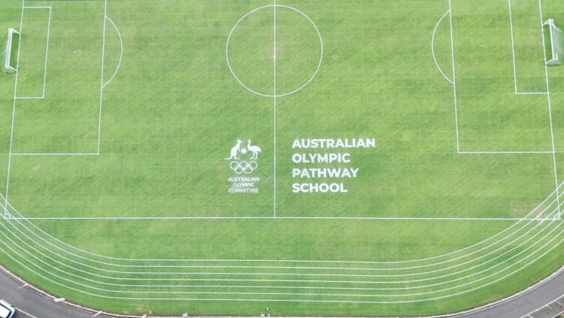
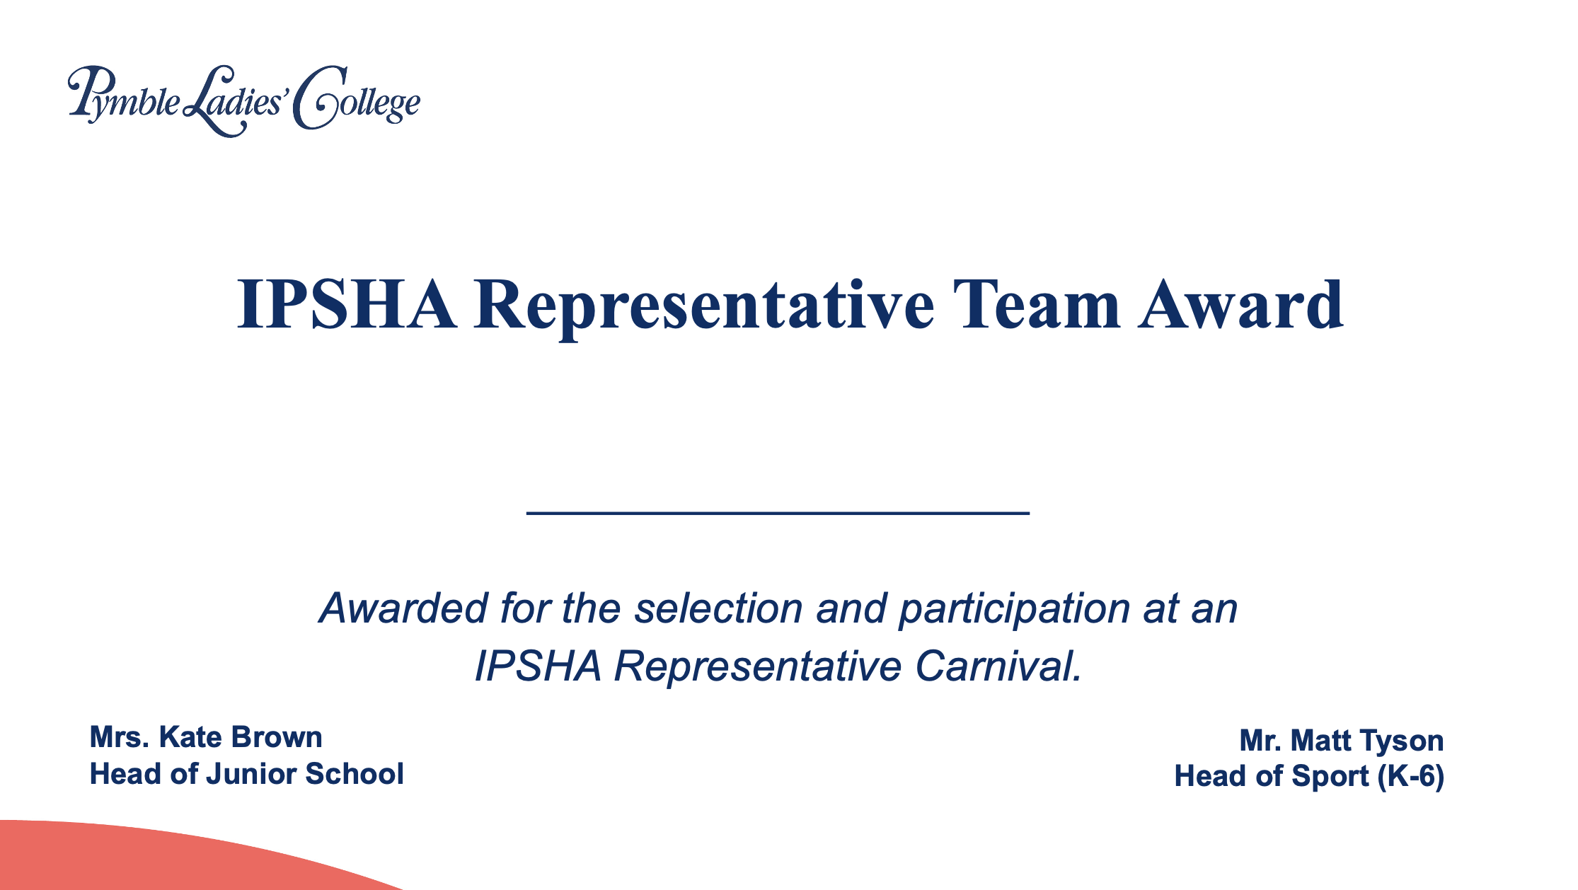
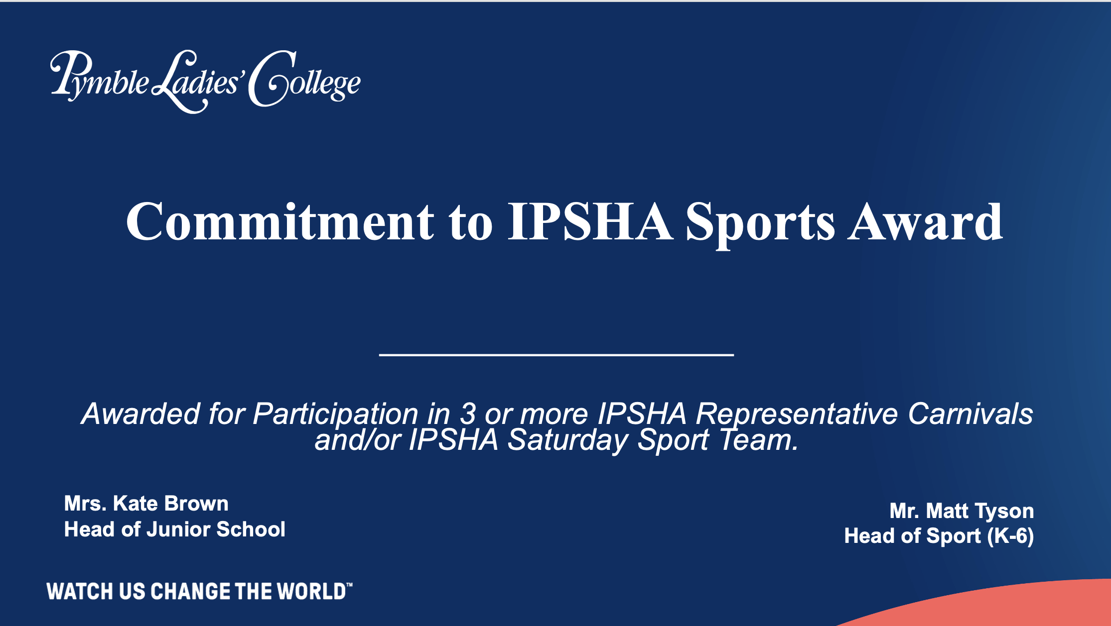
2025 New Programs and Initiatives
Revamped Sports Awards System
Tennis Australia Training Hub
Partnerships - Rafa Nadal Tennis Academy, Barcelona FC and Tottenham FC
Pymble Athletics Academy
Pymble Stride
Dream Diploma

Slide 9
